Slide 1
Discrete Mathematics
Equivalence of Finite Automata and Regular Grammars & Pumping Lemma
Week 11
Ida Bagus Kerthyayana Manuaba
imanuaba@binus.edu

Slide 2
Session Learning Outcomes
Upon completion of this session, students are expected to be able to
define basic discrete structures and its properties including: logic proposition, sets, finite automata, grammars, and matrix.
define the notion of mathematical thinking, mathematical proofs, and recursion.

Slide 3
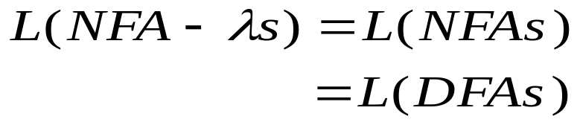
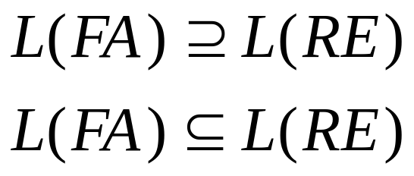
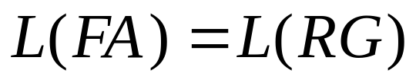
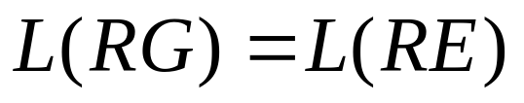
Equivalence of Finite Automata and Regular Grammars
(Parallel Simulation)
(Rabin and Scott’s work)
(Collapsing graphs; Structural Induction)
(S. Kleene’s work)
(Construction)
(Solving linear equations)

Slide 4
Role of various representations for Regular Languages
Closure under complemention. (DFAs)
Closure under union, concatenation, and Kleene star. (NFA-λs, Regular expression.)
    Consequence:
    Closure under intersection by De Morgan’s Laws.
Relationship to context-free languages. (Regular Grammars.)
Ease of specification. (Regular expression.)
Building tokenizers/lexical analyzers. (DFAs)

Slide 5
Application to Scanner (Lexer, Tokenizer)
High-level view
NFA
Regular
expressions
DFA
Lexical
Specification
Table-driven
Implementation of a minimal DFA

Slide 6
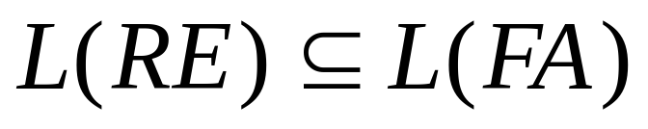
Construction of Finite Automata from Regular Expressions
Show that there are FA for basis elements and there exist constructions on FA for capturing union, concatenation, and Kleene star operations.
M(a)
Basis Case

Slide 7
Constructions on NFA-λs
λ
λ
M(R1)
λ
λ
M(R)
λ
M(R2)
λ
M(R*)
M(R1 U R2)
λ
λ
λ
M(R1)
M(R2)
M(R1 R2)

Slide 8
Construction of Regular Expression from Finite Automaton
Expression Graph is a labeled directed graph in which the arcs are labeled by regular expressions. An expression graph, like a state diagram, contains a distinguished start node and a set of accepting nodes.

Slide 9
Examples
ab
L(M) = (ab)*

Slide 10
Examples
b+ a
ba
a u b
L(M) = (b+ a)* (a u b) (ba)*

Slide 11
Examples
ba
bb
b*
a+
L(M) = (b a)* b*( bb u (a+(ba)*b*) )*

Slide 12
Main Idea
To associate an RE with an FA,
  reduce an arbitrary expression graph to one containing at most two nodes,
  by repeatedly removing nodes from the graph and relabeling the arcs to preserve the language.
Without loss of generality, we can assume one accepting state (because of the presence of the union operation).

Slide 13
Example
qj
qi
qk
Wj,i
Wi,k
qj
qk
Wj,i Wi,k

Slide 14
Wi,i
qj
qk
Wj,i
Wi,k
qi
qj
qk
Wj,i (Wi,i)* Wi,k

Slide 15
Final Graph : Alternative 1
u
L(M) = (u)*

Slide 16
Final Graph : Alternative 2
u
w
v
x
L(M) = (u)* v( w u (x (u)* v) )*

Slide 17
Detailed Example
b
q0
q1
a
a
b
b
a
q2
q3
b

Slide 18
Delete node q1
b
q0
q1
a
bb
ab
a
b
b
a
q2
q3
b

Slide 19
Delete node q2
ab*ab
q0
a
b u bb
ab
a
q2
q3
b

Slide 20
Finally
ab*ab
q0
b u bb
a
q3
(ab*ab)*a ((bubb) (ab*ab)*a)*

Slide 21
Two Equivalent (Right-linear) Regular Grammars
<q0> -> a <q0>
| a <q1>
<q1> -> b <q1>
| b <q2>
<q2> -> λ
<{q0}> -> a <{q0,q1}>
<{q0,q1}> ->
a <{q0,q1}>
| b <{q1,q2}>
<{q1,q2}> -> λ
| b <{q1,q2}>
All productions involving <{}> can be deleted, as <{}> does not derive any terminal strings.
Notes:
<q0> and {<q0>} are the start symbols in the two grammars.
Intuition: Constructs string from left to right.
Intuition: Language associated with a non-terminal is the set of strings that take the m/c from that (non-terminal) state to an accepting state.

Slide 22
Two Equivalent (Left-linear) Regular Grammars
<q0> -> λ
| <q0> a
<q1> -> <q1> b
| <q0> a
<q2> -> <q1> b
<{q0}> -> λ
<{q0,q1}> ->
<{q0,q1}> a
| <{q0}> a
<{q1,q2}> ->
| <{q0,q1}> b
| <{q1,q2}> b
Notes:
<q2> and <{q1,q2}> are the start symbols in the two grammars.
Intuition: Constructs string from right to left.
Intuition: Language associated with a non-terminal is the set of strings that take the m/c from the start state to the (non-terminal) state.

Slide 23
From Grammars to Finite Automata
S -> aA | cF
A -> bB | bA
B -> λ
F -> λ
S -> aA | c
A -> bB | bA
B -> λ
b
a
A
b
S
B
c
F

Slide 24
From Grammars to Finite Automata
S -> λ
A -> Sa | Ab
B -> Ab
F -> Sc
Z -> B | F
S -> aA | c
A -> bB | bA
B -> λ
b
a
A
b
S
B
c
F

